Slide 1

Fragrance Trend Opportunities:
Market Insights Report
Categories & Notes Analysis – US & UK
Olivia Spinelli

Slide 2
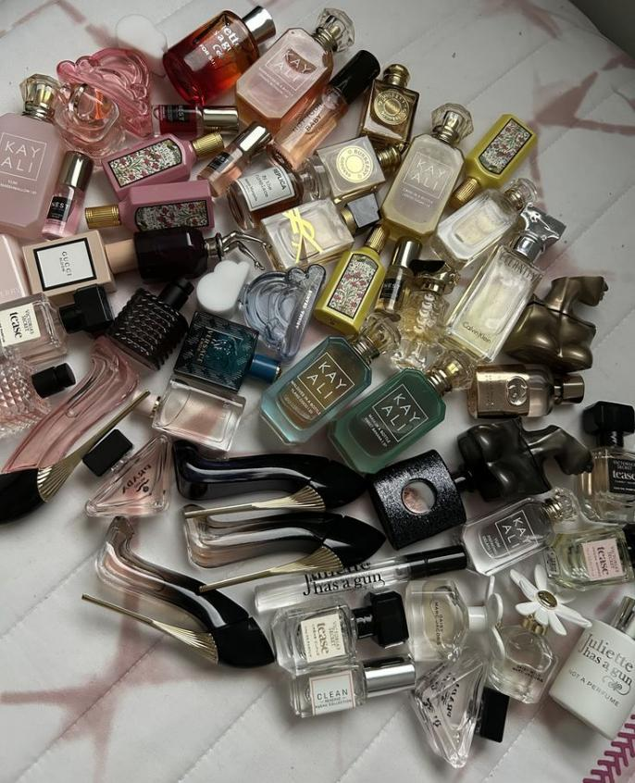





Agenda
Methodology
Categories Insights
Notes Insights
Cross-Market Insights
Recommendations

Slide 3

Executive Summary
Fragrance growth is being driven by a balance of timeless anchors and bold experimentation.
Florals and Fruity notes like Rose, Jasmine, Peach, and Apple continue to lead momentum, while Citrus and Spicy profiles such as Lemon, Orange, and Saffron inject energy and edge, particularly in the US. Core anchors like Vanilla, Sandalwood, and Oud remain dominant but risk oversaturation without modern reinvention. Market dynamics diverge, with the US leaning into gourmand, fruity, and spicy innovation, while the UK maintains strength in green, amber, and heritage-driven profiles. The greatest opportunity lies in elevating underused but high-interest notes, such as Peach, Lavender, and Pear, into modern hero ingredients that bridge tradition with disruption.

Slide 4
Methodology
Steps
This analysis followed a four-step process: collecting multi-source consumer data, structuring it into fragrance categories and notes, calculating a weighted opportunity score, and visualizing insights to identify high-potential areas for innovation.
1
2
3
4
Data Collection
Data Structuring
Opportunity Score
Visualization & Insights
TikTok, Instagram, Google Trends, Fragrantica Dataset from Kaggle
Collected in August 2025
Binary tags: High Interest, Rising, Underused
Cleaned + grouped into Categories & Notes using R
Split into UK vs US datasets
Formula: (Δ Growth + TMS) ÷ Median Supply
Growth prioritized → rising signals
Supply normalized → underused space
TMS anchors → avoids overvaluing blips
Tableau visuals (Categories, Notes, Cross-Market)
Pinpointed sweet spots: high interest + rising + underused

Slide 5
Categories

Slide 6
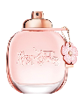
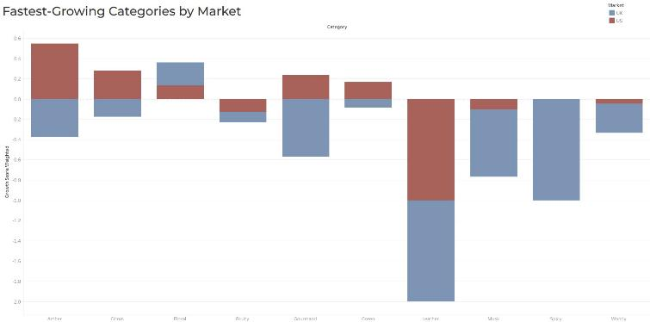
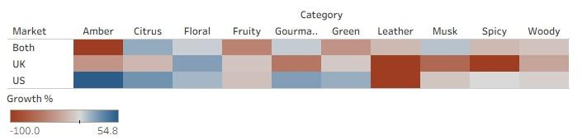

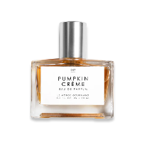


Growth Is Concentrated in Amber While heritage categories stagnate, innovation is clustering around indulgent scent families.
Coach Floral Eau de Parfum has breakout* growth in the UK in Google searches over the past 12 months
Fragrance growth is not evenly distributed. A few categories are driving most of the momentum:
Amber is surging, especially in the US, capturing consumer attention and signaling room for innovation.
Gourmand shows mixed performance — relatively resilient in the US but declining in the UK.
Citrus and Floral remain stable, delivering reliable but modest growth.
Leather, Musk, and Woody are losing ground, with consistent declines across both markets.
This highlights a shift: consumer excitement is moving away from heritage anchors and toward newer, indulgent profiles led by Amber.
Dulce by Rosie Jane has +950% growth in the US in Google searches over the past 12 months
Le Monde Gourmand has breakout* growth in the US in Google searches over the past 12 months
*breakout growth = over 5,000% growth

Slide 7
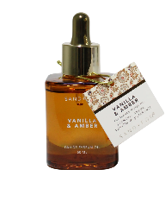
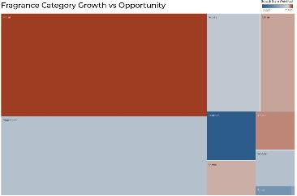
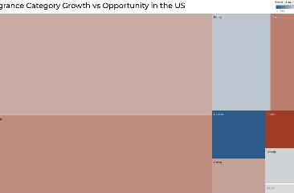
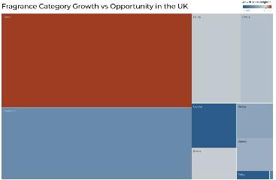
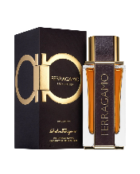
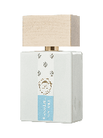

Big Categories Provide Scale, Small Categories Provide Growth
Floral dominates in size across both markets, while Gourmand has emerged as a major mainstream category.
The real breakout bets, however, lie in Amber and Spicy, which—though smaller—show accelerating growth, particularly in the US.
Floral leads in size across markets, making it a stable anchor, though growth is beginning to plateau
Gourmand is the clear #2, steadily expanding into the mainstream and offering scale and growth potential.
Amber and Spicy are high-upside challengers, showing especially strong momentum in the US.
The takeaway: brands must balance scale-driven anchors like Floral and Gourmand with fast-rising challengers like Amber and Spicy to capture both security and future growth.
Sand & Fog Vanilla & Amber has +600% in US Google searches over the past 12 months
Ferragamo Spicy Leather Salvatore Ferragamo has breakout growth in the US in Google searches over the past 12 months
Floral Street Wild Vanilla Orchid has +450% in UK Google searches over the past 12 months
Bianco Latte Giardini Di Toscana has breakout growth in UK Google searches over the past 12 months

Slide 8
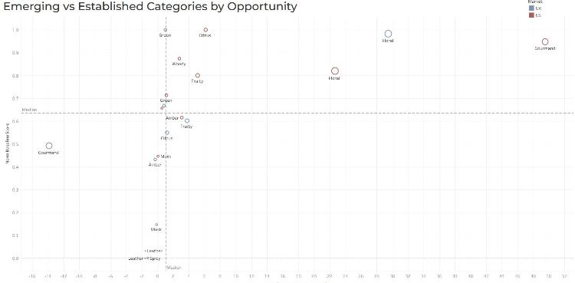
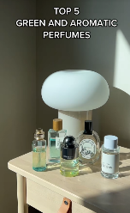
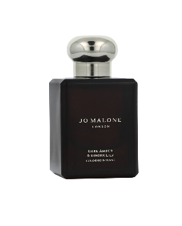
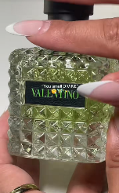
Where the Next Wins Will Come From Floral, Citrus, and Green are safe bets, while Spicy is the breakout disruptor to watch.
Opportunity scores reveal a clear divide between established leaders and emerging disruptors:
Floral, Citrus, and Green rank highest in both strength and momentum, making them reliable growth anchors.
Gourmand signals vary, strong in the US but less consistent in the UK.
Amber shows rising momentum, presenting an underexploited growth space.
Spicy, Leather, Musk, and Fruity remain niche
The sweet spot lies in categories that combine scale with accelerating trend momentum, led by Floral and Citrus, with Amber and US-driven Gourmand emerging as challengers.
Jo Malone Dark Amber & Ginger Lily has breakout growth in UK Google searches over the past 12 months
Green & Citrus are being showcased on TikTok in both markets

Slide 9
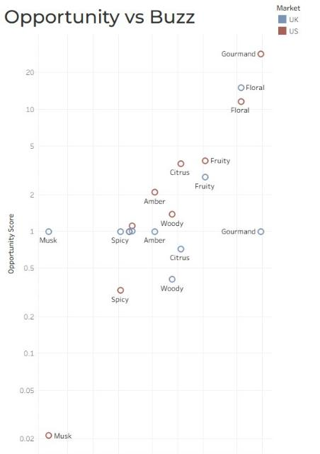


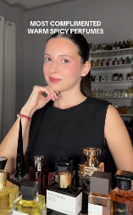
Buzz vs. Reality: The Categories Punching Above (and Below) Their Weight Gourmand leads in hype, but Citrus and Spicy offer untapped growth despite quieter buzz.
Consumer buzz doesn’t always match real opportunity:
Gourmand dominates in buzz, and shows high opportunity in the US, but in the UK it’s more hype-driven with weaker opportunity.
Floral balances both, keeping its place as a strong, reliable anchor.
Citrus and Spicy are sleeper opportunities: high growth potential despite modest buzz.
Amber and Spicy show stronger opportunity relative to their modest buzz, true undervalued opportunities.
This suggests Amber and Spicy are the most underpriced growth bets, while Gourmand risks being overhyped without consistent returns.
Consumers are sharing their top spicy scents on social media

Slide 10
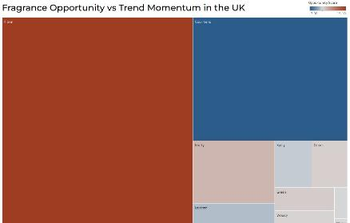
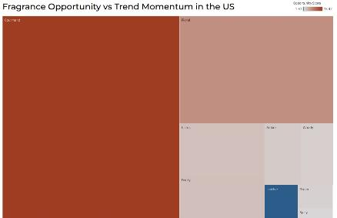
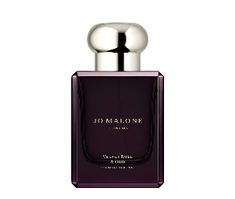

Two Markets, Two Stories
The UK stays traditional, while the US is more experimental and indulgent.
Category dominance plays out differently across the Atlantic:
The UK is anchored by Floral, with Gourmand as a strong secondary player. Other categories remain marginal, reinforcing a traditional market profile.
The US is led by Gourmand, with Floral still significant, but Amber emerging as a challenger alongside mid-tier categories like Citrus and Fruity.
Green, Leather, Woody, and Musk remain niche across both markets, with limited growth traction.
Overall, the UK leans on heritage anchors, while the US shows greater openness to indulgent and emerging categories, making it the more dynamic market.
Jo Malone Velvet Rose & Oud has breakout growth in UK Google searches over the past 12 months
Dossier Spicy Orchid has +200% growth in US Google searches over the past 12 months

Slide 11
Notes

Slide 12

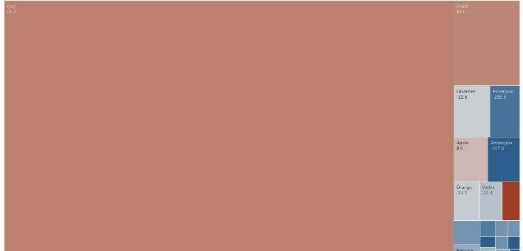
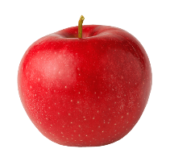
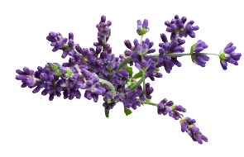
The Sweet Spot: Where Curiosity Outpaces Supply Unlocking whitespace where consumer curiosity meets low market penetration.
Fragrance fans are curious about notes they don’t see often. The data shows several notes that remain underused yet carry opportunity potential:
Oud dominates, signaling strong curiosity but also whitespace for brands to build depth in this high-demand note.
Peach and Apple stand out with consistent consumer pull and moderate positive growth.
Lavender and Violet show heritage strength but are re-emerging in modern contexts despite recent volatility.
Ambergris and Pineapple highlight untapped whitespace, though growth signals are inconsistent, suggesting a need for careful positioning.
This highlights prime whitespace opportunities where brands can differentiate with notes that resonate with consumers but remain underexplored or inconsistently supplied.

Slide 13
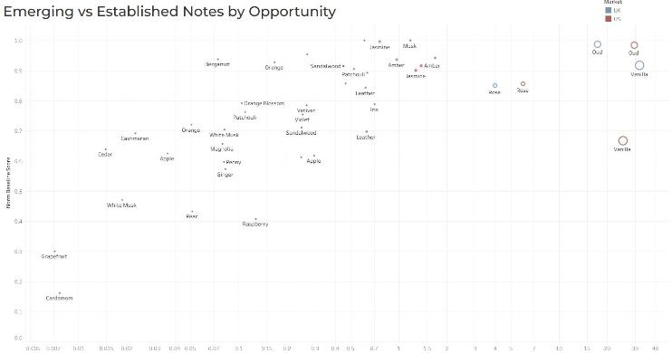

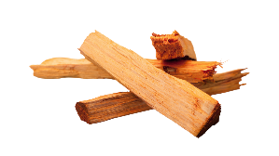


Safe Bets vs Disruptive Innovations The market is split between reliable anchors and breakout challengers.
Fragrance notes fall into three strategic plays:
Safe bets: Rose, Jasmine, Sandalwood, Amber, Musk have strong baseline, steady appeal, and proven stability.
Disruptive innovations: Oud and Vanilla lead as standout high-growth anchors, while Iris, Leather, and Patchouli signal momentum for selective innovation.
Underperformers: Notes such as Cardamom, Grapefruit, and Raspberry show limited traction and remain niche.
The winning strategy is to anchor in proven notes while backing select disruptors like Oud, Vanilla, and emerging challengers that can define tomorrow’s growth curve.

Slide 14

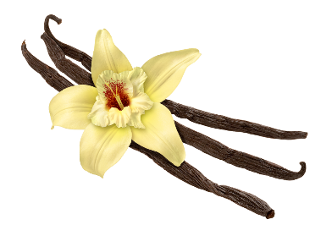
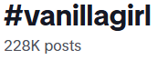
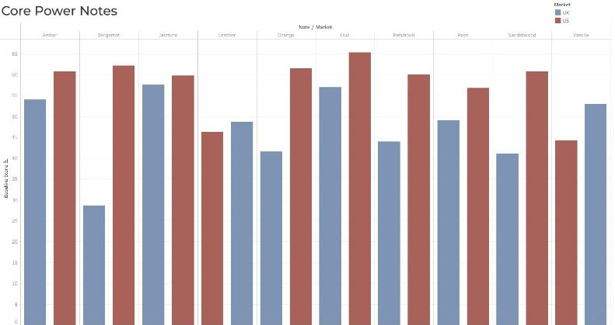



The Notes Dominating Today’s Market
Core power notes define the baseline of fragrance relevance.
A handful of notes dominate across US and UK markets, providing scale and consistency:
Oud, Amber, Bergamot, Rose, Sandalwood, and Jasmine anchor the market with high baseline scores.
The US market over-indexes broadly, especially on Oud, Bergamot, Sandalwood, and Patchouli, signaling strong preference for deep, classic notes.
The UK shows relative strength in Vanilla, Leather, and Orange, but overall trails the US in baseline power.
Leather maintains presence but underperforms relative to the other power notes.
These core notes provide scale and consistency, but with heavy competition, brands must layer fresh spins and innovation to stand out.
Vanilla scents dominate social media, becoming identifiers with aesthetics like Vanilla Girl

Slide 15
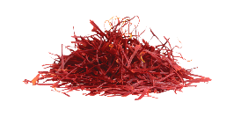
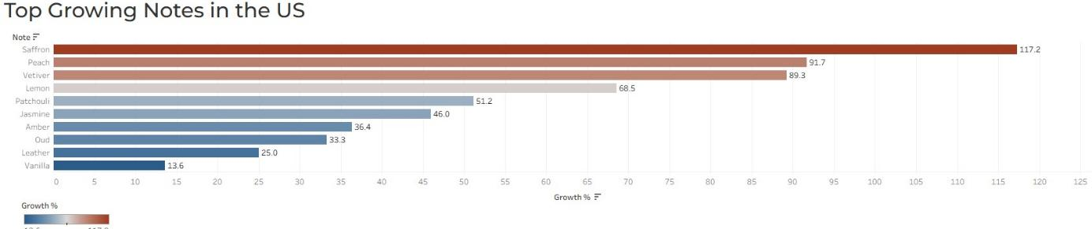
Spotlight on Rising Experimental Notes in the US Experimental notes are fueling momentum, especially in the US.
Growth is being fueled by daring and diverse notes:
Saffron (+117%) and Peach (+92%) are surging, confirming demand for bold, indulgent, and gourmand-forward scents.
Vetiver (+89%) and Lemon (+69%) highlight consumer appetite for fresh, green, and citrus brightness.
Jasmine (+46%) and Patchouli (+51%) sustain growth while balancing heritage appeal with trend-driven relevance.
Oud, Amber, and Leather continue gaining traction, reinforcing their role in modern luxury blends.
Vanilla (+14%) proves comfort notes remain relevant, but growth is tapering after its peak hype.
The momentum suggests a shift toward luxury, gourmand, and bright citrus edges of fragrance, reshaping consumer expectations in the US market.

Slide 16
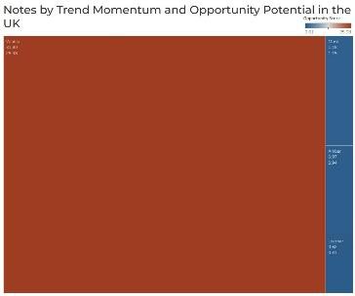
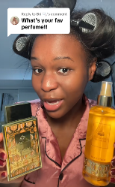
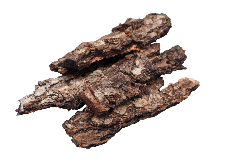
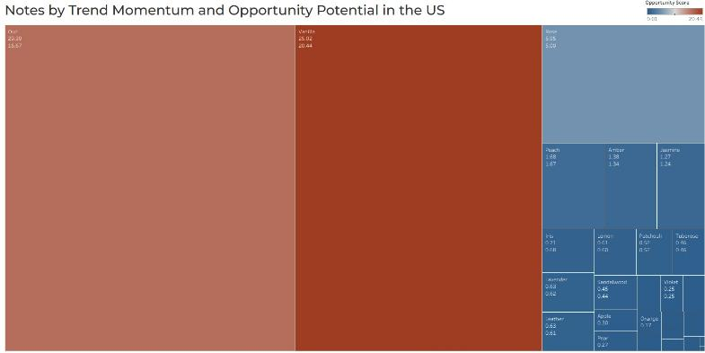
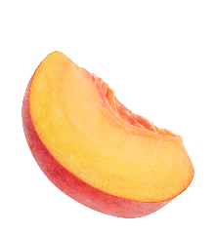

Momentum Meets Opportunity Breakout notes redefine the US landscape, while UK growth is anchored in tradition.
Breakout notes highlight where consumer excitement (momentum) is translating into real market potential (opportunity):
US Market: Oud and Vanilla lead with both high momentum and opportunity, signaling scale and whitespace.
Secondary bets: Rose, Peach, and Jasmine add growth potential with emerging consumer traction.
UK Market: Vanilla dominates, while Musk, Amber, and Leather remain smaller, tradition-led plays.
Global innovation should center on Vanilla and Oud as cross-market anchors, while selectively testing challengers like Rose and Peach to capture new whitespace.
Consumers are raving about their favourite Oud perfumes that leave them smelling heavenly and turning heads.

Slide 17
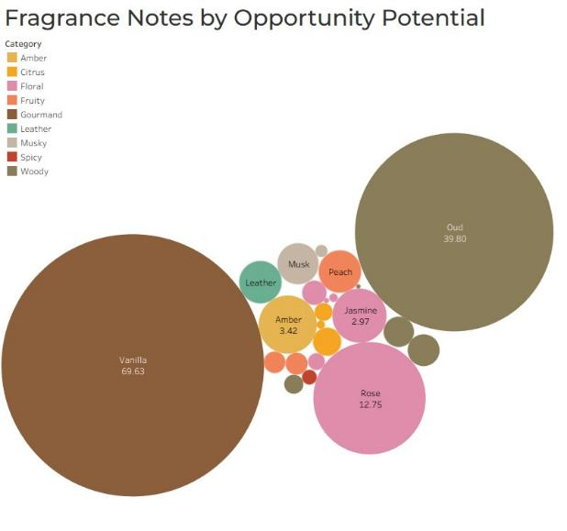



Which Notes Matter Most by Opportunity Visualizing the balance of dominant anchors and emerging notes.
Consumer whitespace is clustering around a mix of rediscovered classics and underutilized notes.
Vanilla and Oud dominate, combining strong consumer pull with whitespace for further premiumization.
Rose and Jasmine remain enduring anchors, balancing tradition with broad familiarity.
Leather and Amber reinforce luxury positioning but play more niche roles.
Smaller notes like Peach and Musk signal emerging potential but remain secondary.
The strongest gains will come from balancing timeless anchors (Vanilla, Rose, Oud) with smaller rediscoveries (Leather, Amber, Peach) to create distinctive yet familiar launches.

Slide 18
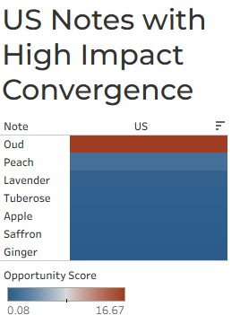
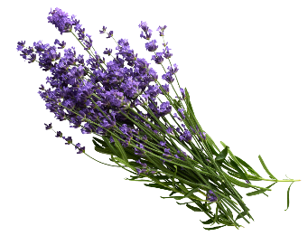
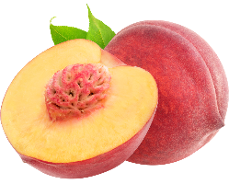
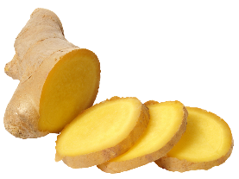
Spotlight on Rising Experimental Notes The US market shows clear convergence of high-growth notes.
In the US, some notes stand out for hitting the sweet spot of combining baseline strength, trend momentum, and cultural buzz:
Oud, Peach, and Saffron emerge as the leading high-growth bets.
Lavender and Tuberose modernize heritage into cross-category relevance.
Apple and Ginger add fresher, youthful angles for mass appeal.
Together, these define the “trifecta notes,” the most future-proof bets shaping US innovation.

Slide 19
Cross Market

Slide 20
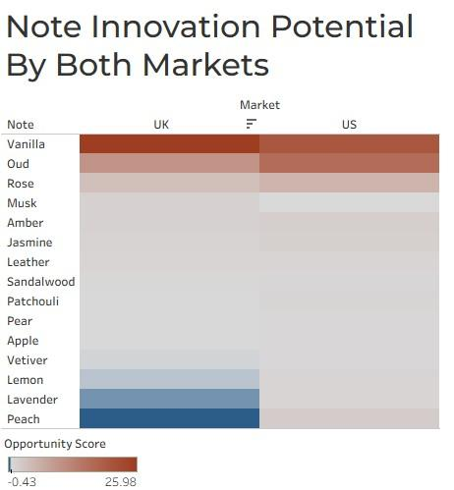
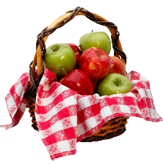
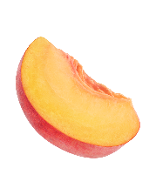
Unlocking Hidden Innovation Potential Both US and UK markets show whitespace in notes ready for reimagination.
Fragrance innovation potential is not evenly distributed. While some notes are firmly established, others signal clear opportunities for reinvention:
Vanilla and Sandalwood remain anchors but risk over-saturation.
Peach, Lavender, and Apple highlight whitespace opportunities with consumer intrigue but lower current penetration.
Rose and Jasmine sustain broad relevance, bridging tradition and modernity.
Oud and Amber reinforce luxury, yet lean more established than exploratory.
Brands can win by reinventing underutilized notes into premium, modern formats, balancing established anchors with whitespace rediscoveries.

Slide 21
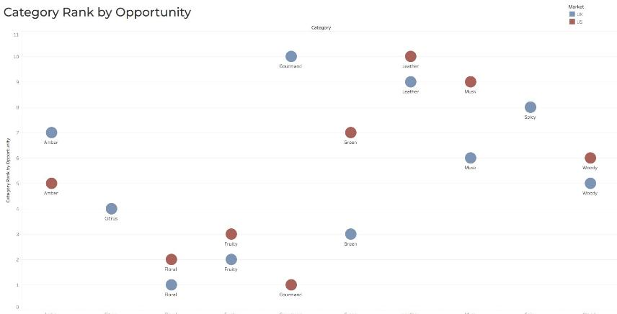
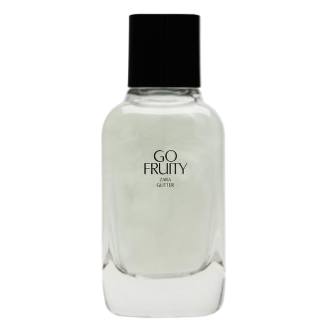

Categories Tell Two Stories Across Markets Category priorities differ in the US and UK, shaping opportunity maps.
When categories are ranked by opportunity:
Floral dominates both markets, but is even more entrenched in the UK.
Gourmand leads the US, showing the strongest overall ranking, but slips to the bottom in the UK.
Fruity performs well across both markets, signaling steady consumer appeal.
Green and Amber diverge, where Green ranks higher in the UK, while Amber shows stronger opportunity in the US.
The divergence underscores the need for localized innovation strategies that balance global anchors with market-specific growth opportunities.
Zara Go Fruity Glitter has +900% growth in US Google searches over the past 12 months

Slide 22
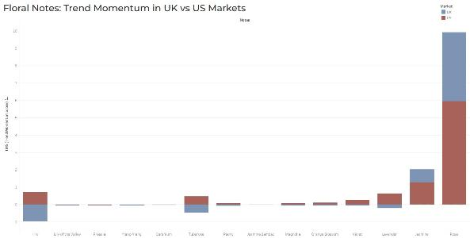
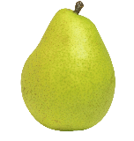
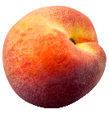

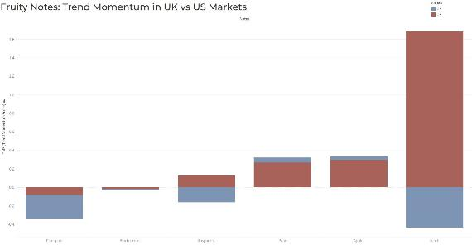



Florals and Fruity: The Bridge Between Heritage and Innovation Floral and fruity notes are redefining tradition through playful freshness and modern revival.
Together, florals and fruity notes bridge tradition and experimentation, making them central to next-gen hero launches.
Floral notes remain timeless anchors, with Rose leading momentum across both markets. Jasmine and Tuberose are gaining renewed relevance, showing how classic notes are being modernized.
Fruity notes bring fresh dynamism. Peach emerges as a breakout star in the US, while Apple and Pear serve as versatile complements across both regions.

Slide 23
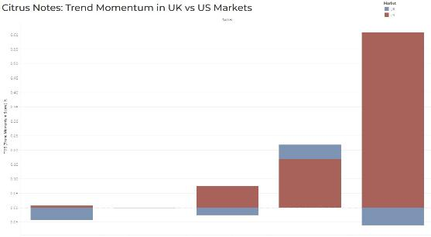





Citrus and Spice: Energizing the Market Zesty and spicy notes drive experimentation, especially in the US.
Citrus and spice together fuel the shift toward vibrant and daring sensory experiences.
Lemon dominates US momentum, driving the citrus category with bright, bold appeal. Orange also shows steady growth, particularly in the UK.
Spices are gaining ground, with Saffron emerging in the US as a high-growth disruptor. Ginger also shows promising crossover momentum, signaling appetite for bold, edgy profiles.

Slide 24





Anchors with a Twist: Amber, Woody, and Gourmand Notes Strong foundations evolve through premium reinterpretations.
These categories provide scale and security, but innovation lies in reimagining them for modern palettes.
Amber maintains strong baseline strength, particularly in the UK, anchoring luxury positioning while leaving space for nuanced variations.
Oud continues to dominate momentum globally, especially in the US, where it combines luxury depth with mass intrigue.
Vanilla drives the gourmand trend across both markets, but its ubiquity calls for reinvention through blends with experimental notes.

Slide 25
Key Takeaways

Slide 26
Key Takeaways US drives novelty and momentum, the UK leans on heritage anchors, and both share whitespace in rediscovered and underused notes.
US
UK
BOTH
Momentum-Led & Experimental
Heritage Anchored & Evolving
Rediscovery & Whitespace
The US fragrance market thrives on speed and bold experimentation, with consumers quick to adopt new breakout notes like saffron, peach, and oud. Citrus and spice add vibrancy, while rediscoveries like leather and lavender are being reimagined for modern blends. This environment rewards early movers who can capture and scale high-growth notes quickly.
In contrast, the UK market is grounded in heritage and tradition, where consumers show loyalty to classic anchors like rose, vanilla, and musk. Growth is steadier, with fruity complements like pear and apple adding freshness at the edges. Innovation still matters, but it succeeds when introduced through familiar, trusted cues.
Across both markets, whitespace emerges in rediscovered classics such as oud, leather, and amber, as well as underused green notes like oakmoss and moss. Vanilla dominates but risks oversaturation, requiring new twists to stay relevant. The biggest wins will come from balancing timeless anchors with fresh rediscoveries, creating launches that feel both distinctive and familiar.

Slide 27
Recommendations

Slide 28
Recommendations
Dual-Market Anchors: Vanilla, Rose, Jasmine, Woody
1
These remain the shared backbone across US and UK markets. Reinforce them as trusted category anchors, while innovating through layering and blending with rediscoveries to avoid saturation.
US Innovation Push: Saffron, Peach, Oud, Ginger, Lavender
2
The US thrives on speed and novelty, rewarding bold experimentation. Focus innovation on high-growth disruptors like saffron and peach, while reimagining oud and ginger for modern premium blends. Use lavender’s cross-category appeal to bridge tradition with trend.
UK Heritage + Controlled Innovation: Rose, Vanilla, Musk, Pear, Apple
3
UK consumers lean on heritage anchors and trusted profiles. Introduce innovation carefully through limited editions or twists on classics, such as fruity complements (pear, apple) layered with rose or musk. This balances familiar cues with subtle freshness.
Rediscovery & Green Revival: Leather, Amber, Oakmoss, Moss
4
Whitespace lies in underused and rediscovered notes, particularly green and leathery profiles. Positioning a “Rediscovery Platform” around oakmoss, moss, leather, and amber can create distinctive launches that feel both premium and familiar, resonating across both markets.

Slide 29
THANK YOU

